Slide 1
Wind Compensation for Small Sounding Rockets
  Blowing winds move all
  Rockets too, oft way off course
  Science fixes that
Seventh IREC, June 2012
Green River, UT
C. P. Hoult & Ashlee Espinoza
CSULB
Also Eighth IREC, June 2013
C. P. Hoult and Elvia Cortez
CSULA

Slide 2
Topic Outline
Wind measurement
Launcher compensation
Summary

Slide 3
Wind Measurement

Slide 4
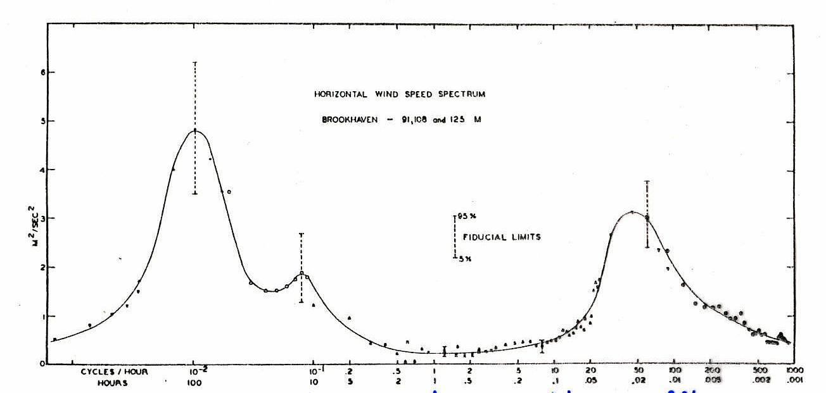
Wind Power Spectral Density
cyclonic
weather
turbulence
diurnal breezes
100 hours
1 hour
0.01 hour
Isaac Van der Hoven, “Power Spectrum of Horizontal Wind Speed in the Frequency Range from 0.0007 to 900 Cycles per Hour”, Journal of Meteorology, Vol 14 (1957), pp 160-164

Slide 5
Space and Time Scales
Lowest frequency peak (~100 hour period, (Bjerknes)) is associated with cyclonic (frontal) weather
Middle frequency peak (~ 12 hour period) is associated with diurnal breezes (common in coastal locations)
Highest frequency peak (~ 0.01 hour period) is associated with tropospheric turbulence driven by
  Turbulent planetary boundary layer motions
  Rising warm air cells (thermals)
Spatial extent found from typical phenomenological velocities
  Cyclonic weather: 100 * 40 km/hr = 4000 km
  Diurnal breezes: 12 * 10 km/hr = 120 km
  Vertical distance scale ≈ 10 km.
  Gravity constrains cyclonic weather & diurnal breezes (≈ 2D horizontal plane)
  Turbulence: 0.01 * 3 km/hr = 300 m (≈ 3D isotropic)

Slide 6
Weather Balloons
Classical sounding rocket approach
  Release a sequence of free pilot balloons (pibals) that drift latterly with the horizontal wind field
  Track these optically with two theodolites that regularly report pibal angular positions
  Estimate three pibal coordinates using
  a ”split-the-difference” algorithm
  Filter the position data to obtain wind vector
  Main problem is pibals ascend erratically
  even in still air…more on that later
Winds so measured will reflect frontal weather and diurnal breezes
  Gusts add noise
  Most recently measured winds used to predict rocket trajectory
Major drawback is costs well beyond what we can afford
Line of closest approach
LOS 2
LOS 1
Estimated position

Slide 7
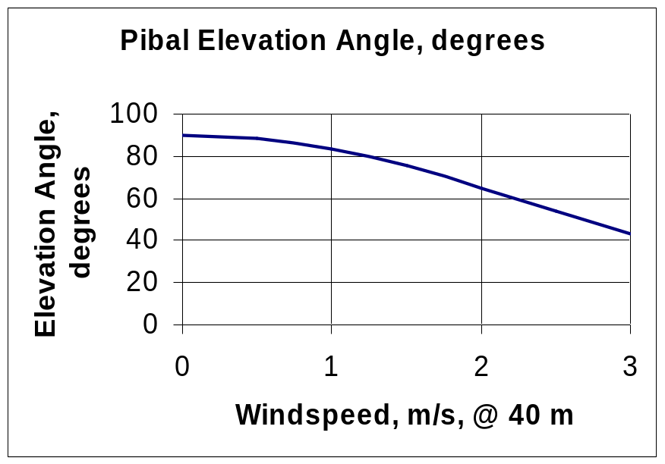
Tethered Pilot Balloon (Pibal) Wind Sensor
Typical Data
Pibal*
  Type: Natural rubber
  Diameter: 118 cm (inflated)
  Weight: 200 gm
  Net lift: ~800 gm
  Drag coefficient**:
  0.14 (Re = 10⁶)
Tether***
  Material: braided Fins
  Spectra 2000 ®
  Diameter: 0.033 cm
  Tensile strength: 22.7 kg
  Weight: 0.083 gm/m
  Altitude: 40 m
Wind
Drag
Pibal
LOS
Catenary Tether
Elevation Angle
Sensor Optics
* Scientific Sales, Inc. web site
** S.F.Hoerner, “Fluid-Dynamic
Drag”, 1965
*** Honeywell literature

Slide 8
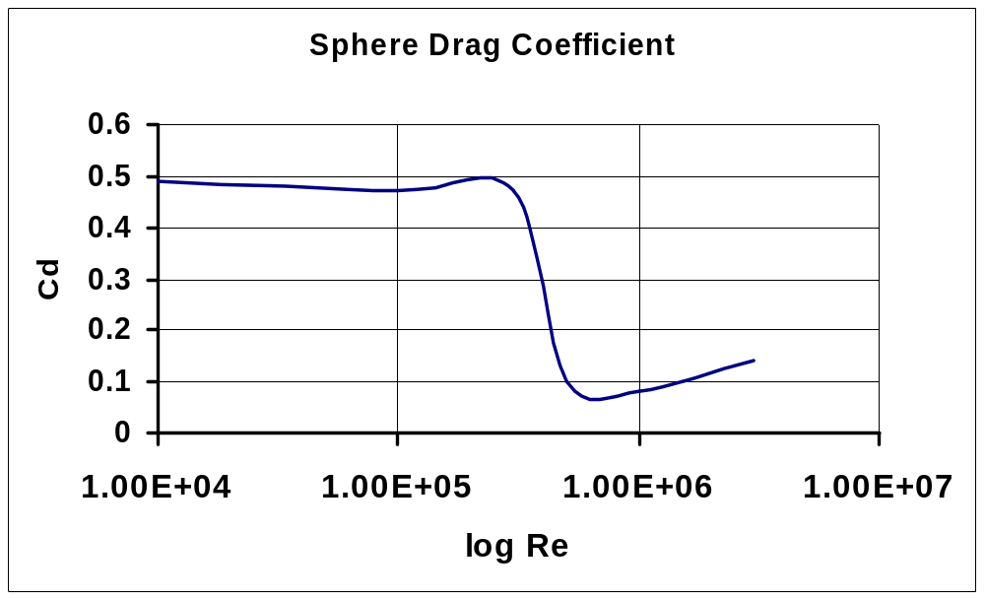
Drag Coefficient of a Sphere

Slide 9
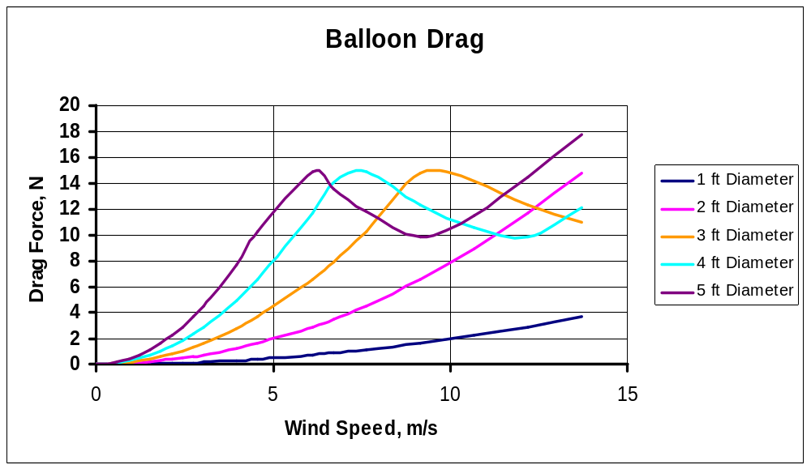
Effect of Balloon Diameter
Select Three Foot Balloon Diameter to Provide Good Visibility and Acceptable Response for wind speeds < 7 m/s

Slide 10
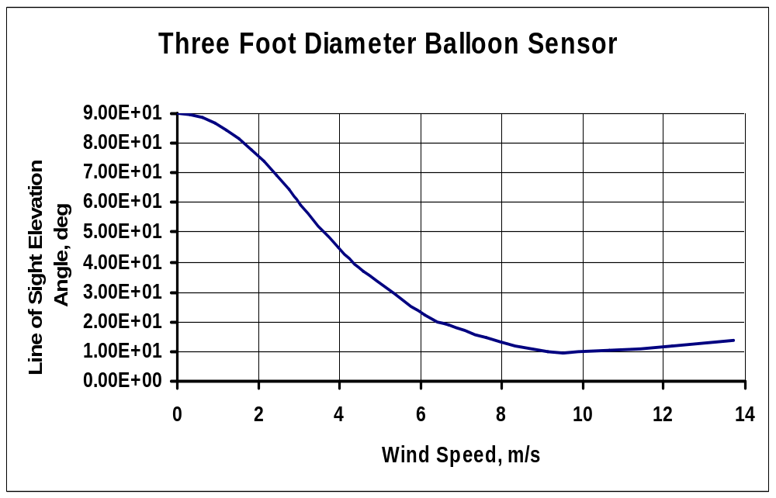
Three Foot Balloon Response Curve

Slide 11
Balloon
Inflation Techniques
  Template to control diameter
Sources

Slide 12
Winch & Spectra™
Spectra™ 2000, the wonder material
Made of polyethylene
How strong it is…15x steel at same weight
Used for fishing line & bullet-proof vests
How thin ours is: 0.011” diameter!
Bias errors from sag due to gravity and aerodynamic drag compensated in software
Winch design & operations

Slide 13
SkyScout™
How it works
  Accelerometers for elevation angle
  Magnetometers for azimuth angle
  GPS to locate Earth’s magnetic field
  Computer
How to use it…settings & which windows have our angles
Telescope & Tripod
  BTW, also good for star parties

Slide 14
Wind Measurement at Higher Altitudes
Tethered Pibal wind measurement works up to about 1 km altitude
  But our rockets fly much higher than that. What’s to be done?
Answer: Don’t worry!
  We can get the high altitude winds from the FAA via the Internet
  Go to Winds and Temperatures Aloft – Air Sports Net
    Select one of about 100 American cities near launch site
    Select Forecast hours of applicability
    Select Azimuth directions
Enter FAA and tethered pibal wind data into
WIND CALCULATOR.xlsx
Product is N-S and E-W wind profiles

Slide 15
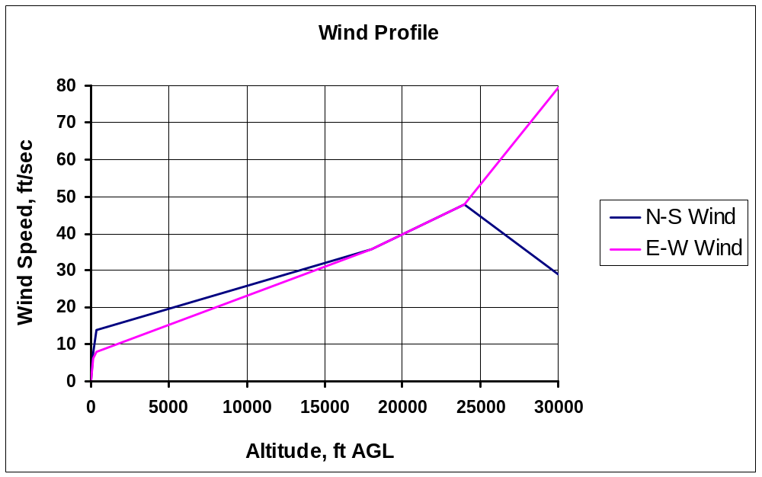
Typical Wind Profiles

Slide 16
Wind Compensation

Slide 17
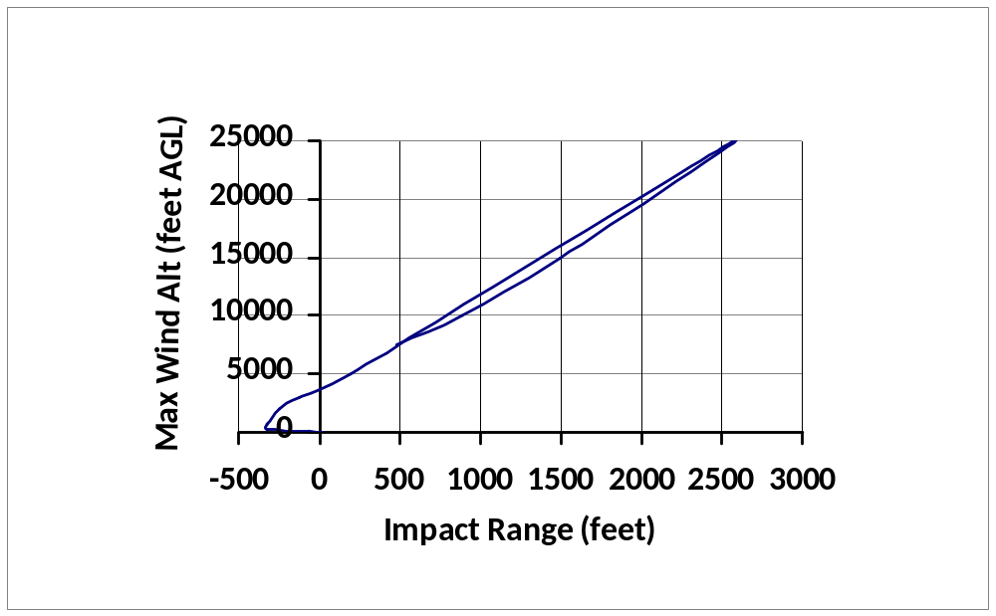
Sonic Eagle Wind Response
Altitude, ft AGL
Linear Approx.
Max
0 10
Wind Speed, ft/sec
Above curve generated by a sequence of SKYAERO runs with 10 ft/sec square wave wind profiles as sketched on the right
Rocket deploys its drogue parachute just below 25,000 ft AGL
Response to high altitude winds dominated by downwind drift on drogue parachute…nearly linear with altitude above 2500 ft
Get high altitude winds aloft from FAA on Internet
Get low altitude winds from tethered pilot balloon measurements

Slide 18
Wind Compensation
Use a precision trajectory simulation like SKYAERO7.6.xls
  Based on Lewis* method wind response
  Corrected for finite inertia near launch
Process
  Enter the N – S and E –S wind profiles into SKYAERO7.6.xls
  Enter the desired trajectory azimuth into SKYAERO7.6.xls
  SKYAERO7.6.xls re-resolves the wind profiles into in plane and cross plane profiles
SKYAERO7.6 run list
  Impact point displacement for in plane winds at QE = 90º
  Impact point displacement for cross plane winds at QE = 90º
  Impact point displacement for no wind and QE = 88º, 86º, 84º, 82º & 80º
  *J.V.Lewis, “The Effect of Wind and Rotation of the Earth on Unguided Rockets”, Ballistic Research Laboratories Report No. 685, March, 1949

Slide 19
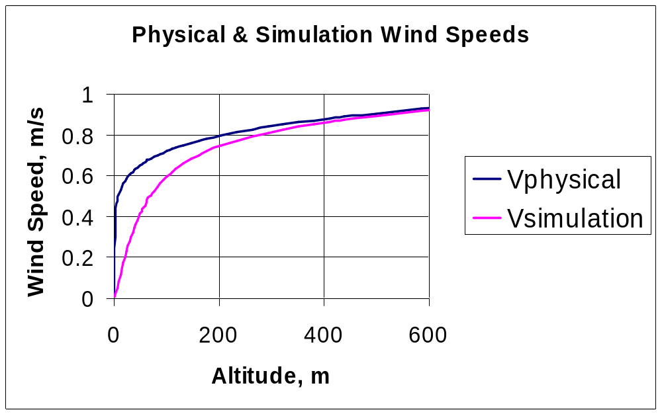
3 DOF Simulation Wind Profile
Lewis method assumes the rocket instantly heads into the relative wind (zero α all the way)
Finite Inertia Correction Factor
  Only applied to ascending trajectory leg
  Vsimulation = Vphysical for descending trajectory leg
3 DOF Lewis method results using Vsimulation closely approximates 6 DOF results using Vphysical
  Initial pitch/yaw wavelength of 200 m and wind profile ≈ altitude^{1/7}

Slide 20
Launcher Settings
Use LAUNCHER ANGLES.xls
Enter the SKYAERO7.6.xls trajectory data into LAUNCHER ANGLES.xls
  Basic assumption is that for nearly vertical launches, the effects of N – S winds, E – W winds and launcher tilt angle are all approximately independent
Use LAUNCHER ANGLES.xls to compute the launcher QE and azimuth for the desired impact point location
  LAUNCHER ANGLES.xls first finds in plane and cross plane QEs,
  Then finds the total launcher angles assuming all angles are small

Slide 21
Total Launcher Adjustments
Find the total launcher tilt, QE_{T}, and azimuth, AZ_{T}
Mind those signs
North
Approximate solution
AZ_{T}
QE_{I}
AZ
QE_{T} = √ QE_{I}² + QE_{C}²,
and
AZ_{T} = AZ + tan⁻¹(QE_{C}/QE_{I})
QE_{T}
QE_{C}
Sketch for positive QE_{I} & QE_{C} launcher tilts

Slide 22
Summary
Wind compensation of sounding rocket impact points is a mature art routinely practiced over many decades

